Slide 1


Capstone Presentation
on
Identity and Access Management
Submitted in partial fulfillment for the award of the degree of
B.Tech Electronics and Communication Engineering
by
Chirag Gaur-18BEC0021
School of Electronics Engineering

Slide 2

Table of Contents
Internship Completion Certificate
About the company
Objective
Problem Statement
Solution
Boot Camp I on IAM
Boot Camp II on SailPoint
Boot Camp III on Ping Identity
Results
Conclusion
References

Slide 3
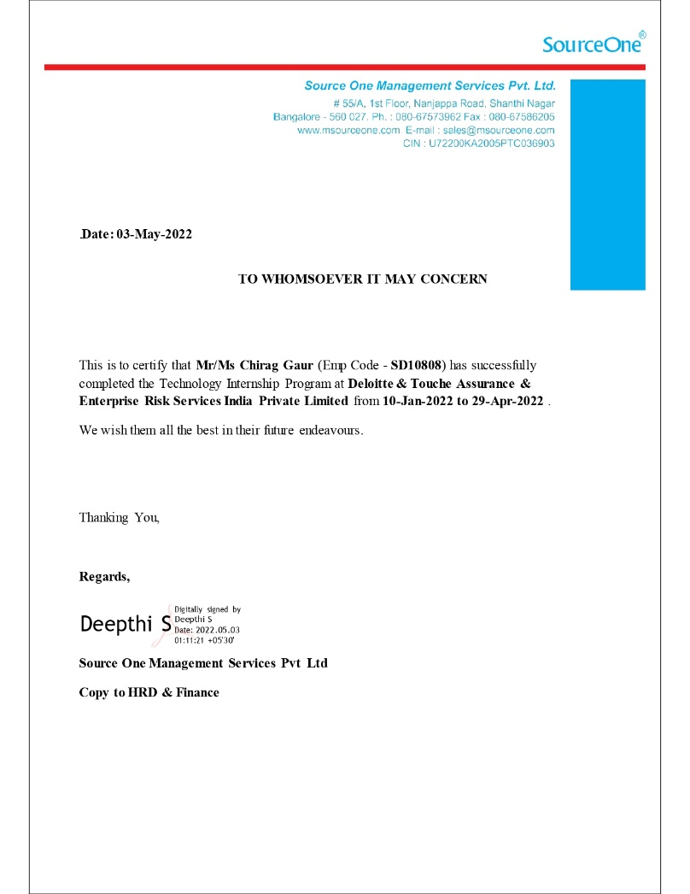
Internship Completion Certificate

Slide 4
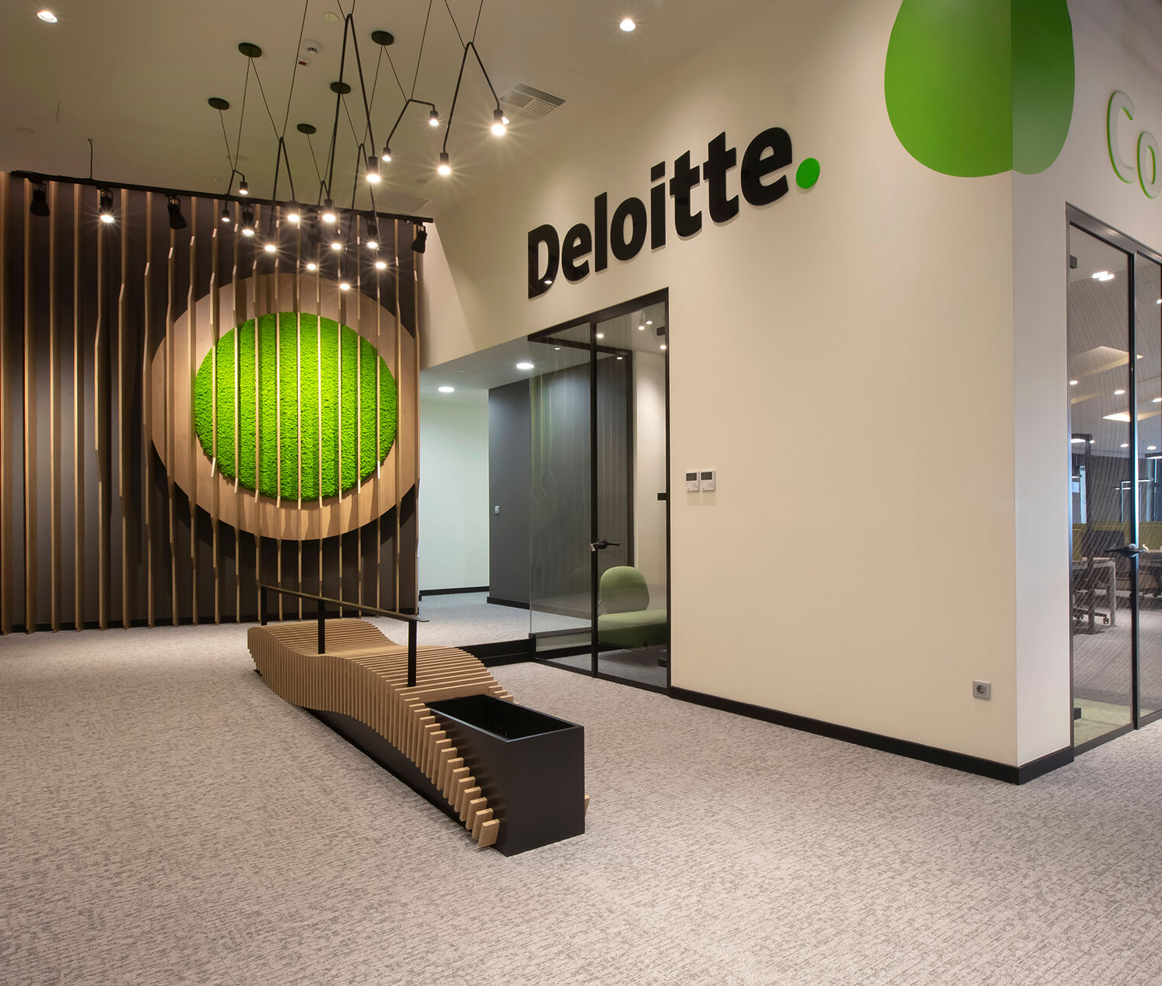
About the company
Deloitte is a multinational expert offerings community with workplaces in over a hundred and fifty international locations and territories across the globe.
Deloitte is headquartered in London, England, and is one of the Big Four accounting firms. Deloitte gives audit, consulting, monetary advisory, threat advisory, tax, and prison offerings with about 334,800 experts globally.
Deloitte gives offerings to more than 90% of customers proposing in Fortune 500.
Deloitte has been a home for tens and hundreds of professionals who dream to create a future for themselves in this speedy developing world

Slide 5
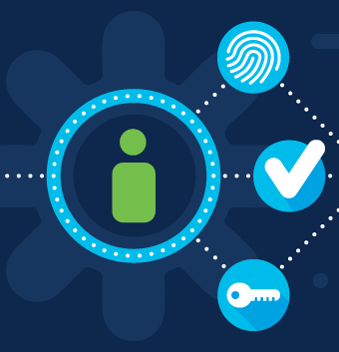
Objectives
My internship’s major goal was to understand Identity and Web Access Management.
PingIdentity products were used as the tools to demonstrate the concepts of Authentication, Authorization, Single Sign-On (SSO).
Some of the use-cases were also implemented with the PingIdentity products.

Slide 6
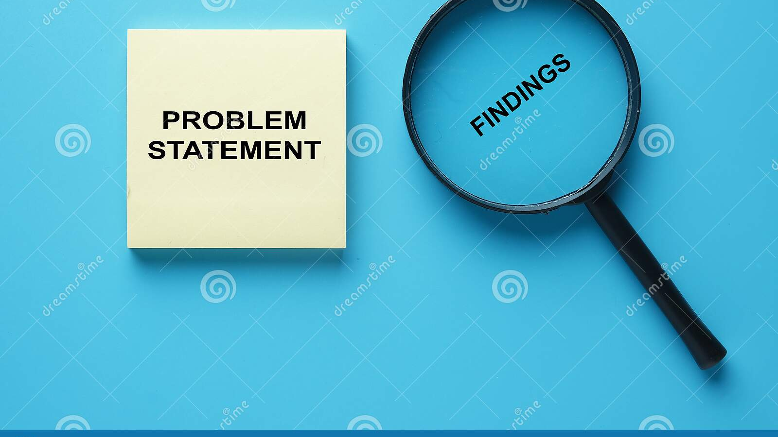
Problem Statement
Generally, there are numerous employees in an organization and at different positions and domains. This creates a lot of manual work of giving different access level to resources to the employees having different working roles.
The product required us to get a better understanding of the concepts of Authentication, Authorization, Single Sign-On (SSO). For this we were required to use PingIdentity products as tools to demonstrate the Authentication, Authorization, SSO.

Slide 7

Solution
Identity and Access Management monitors the lifespan of user identities and entitlements across all corporate resources, including data centers and the cloud. It authenticates users and limits access to systems, networks, and data, making it a fundamental control of cloud security.
IAM keeps a check on the security of all sensitive information of an organization. It allows businesses to restrict access to existing enterprise platforms while also facilitating cloud migration.
When access is judged high-risk, access management features provide adaptive authentication, which reduces risk by increasing login restrictions for users based on device, location, and behavior.

Slide 8

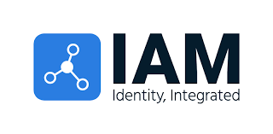


Boot Camp I IAM

Slide 9
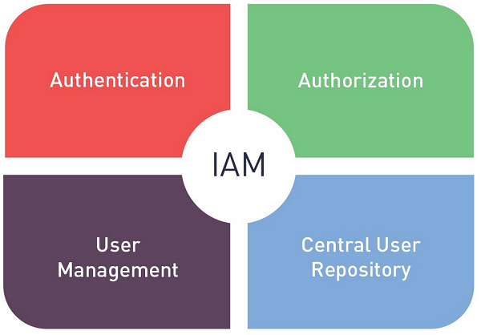
Introduction to IAM
IAM stands for Identity and Access Management. IAM ensures that the right people and job roles in an organization can access the tools they needed to do their jobs.
IAM acts as an interface between identity of the users and the resources that users want to access.
IAM specifies that correct permissions be given to the correct employees for the various applications of the organization.

Slide 10
Terminologies in IAM
Digital Identity/Identity: The digital representation of a user, including a unique identifier, credentials, core attributes, and context-specific attributes.
Authentication (AuthN): The process of establishing a user’s identity by providing a login ID and password in order to access one or more information systems.
Authorization (AuthZ): The process of determining whether a user is permitted to access an application or data.
Provisioning: IAM service responsible for creation of user accounts in information technology (IT) resources and providing appropriate access to those accounts.
Self service: Enabling end user to perform specific activities (e.g., password reset, access request) without the requirements to call service desk.
Authoritative Source: An authorised origination point or “source of truth” for a piece of data (e.g. HR for employee) about a user identity.
Connector/Adapter: Technology used by IAM System to interface and interact with managed systems.
IT Resource/System: Application, system, platform for which access is required to perform a specific function. IAM integrates with these IT resources for user account management.

Slide 11
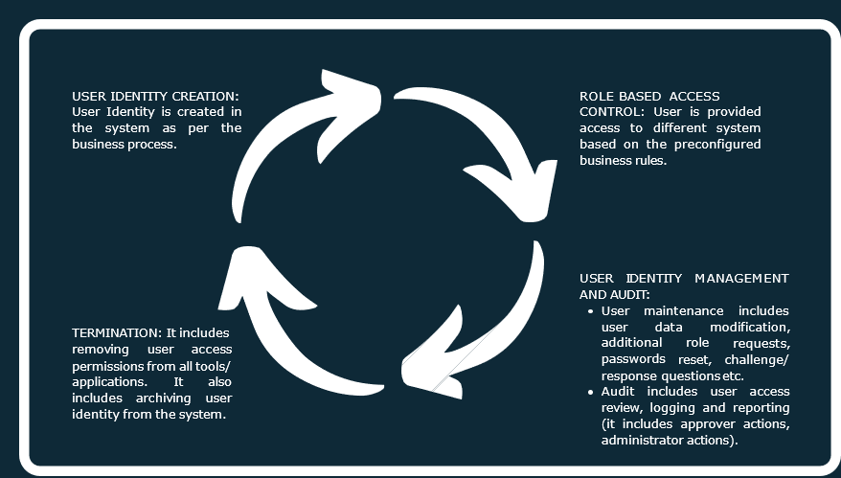
Identity Life Cycle Management

Slide 12
Problems solved using IAM
IT Admin
Too many user stores, password change and account access requests
Manual account creation and synchronization
Multiple user repositories exist that are not reconciled, increasing administrative complexity and the potential for outdated or orphaned accounts. Identity theft is constantly attempted in unprotected zones of your network.
Developer
Redundant code in each application for authentication and authorization
Rework code too often as the application, product,
End User
Users with multiple accounts compromise security through inadequate credential management.
Too many passwords to manage
Long waits for access to business applications and resources
Auditors and Regulators
Limited auditing/reporting ability
Inadequate detection points in business processes create security gaps that are not detected by standard auditing monitors.
Personally identifiable information, such as a person's address and social security number, is not monitored or audited for access compliance with existing laws or organizational policy.
Business Owner
Too expensive to reach new partners, channels
Need for control/approval for access to application
Affiliated organizations are not integrated into a security monitoring program.

Slide 13

Boot Camp II SailPoint

Slide 14
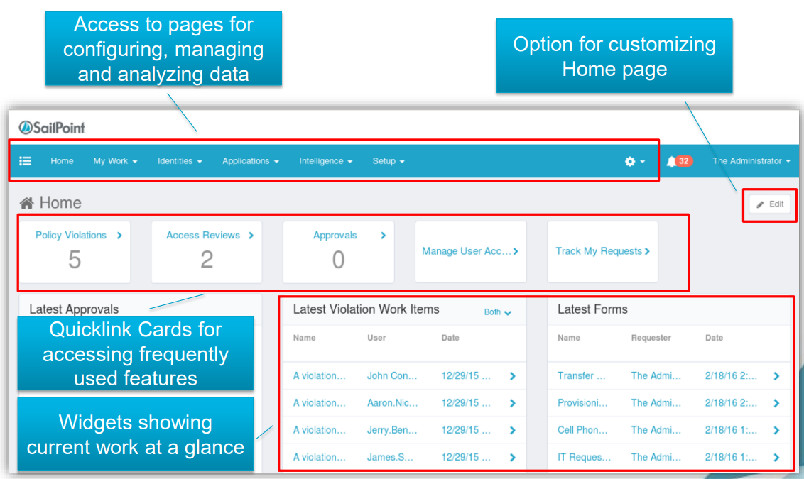
Introduction to SailPoint
SailPoint is an automated version of identity management that lowers the expense and complexity of identity management for users while still granting them access.
SailPoint Identity IQ is made up of four main components:
Compliance Manager.
Lifecycle Manager.
Governance Platform.
User Provisioning.

Slide 15

Need for SailPoint
In small organization with less employess, a proper IAM solution may or may not be necessary.
However, as an organization grows, manpower increases, and the corresponding applications used by them increases too. In order to manage the permissions for the different applications IAM solutions now become an integral part of the organization.
Employing an effective IAM solution, increases the productivity of an organization and secures the organization from various security disruptions.
SailPoint’s Identity IQ solution automates the various IT processes and helps organizations to be complaint with various regulations. IAM strategies will be different for small and large organizations.

Slide 16
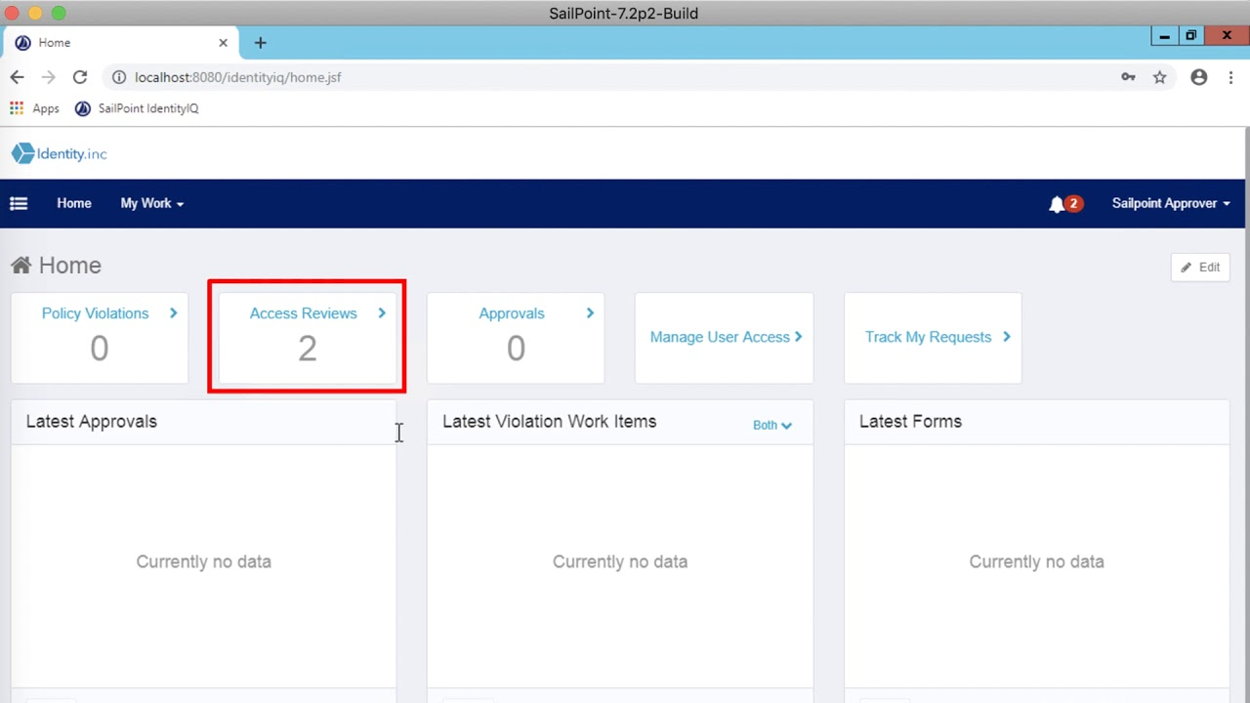
SailPoint Functional Elements
Tasks: Tasks are used to process the data.
Workflow: Standard predefined steps in SailPoint.
Homepage: IdentityIQ home page comprises of various quick links which is used for accessing frequently used features.
Work Items: Work Items are work that the user needs to complete.
Rules: Rules are Snippets of user code written to inject business logic

Slide 17
Use Case I on SailPoint
Problem Statement: To load and correlate the Financials application. This application is used by people in the Finance department. This application data includes entitlement data as well as account data.
Solution: We will correlate user accounts from this financials application to existing Identity Cubes. We will do this by defining an Account Correlation configuration when we configure the application. Account Correlation can be configured as a simple attribute mapping.

Slide 18
Use Case II on SailPoint
Problem Statement: The objective of this use case is to create Identity Cubes from authoritative sources, create new extended identity attributes and mapping identity attributes.
Overview: Assume client has authoritative data stored in two sources. An HR application, stores employee data, and the other application stores contractor data. When defining the applications, Identity Attribute would be “employeeId” and “fullName” as the Display Attribute. I would also create an additional Identity Attribute called “Status” to determine if a user is an Employee or Contractor.

Slide 19
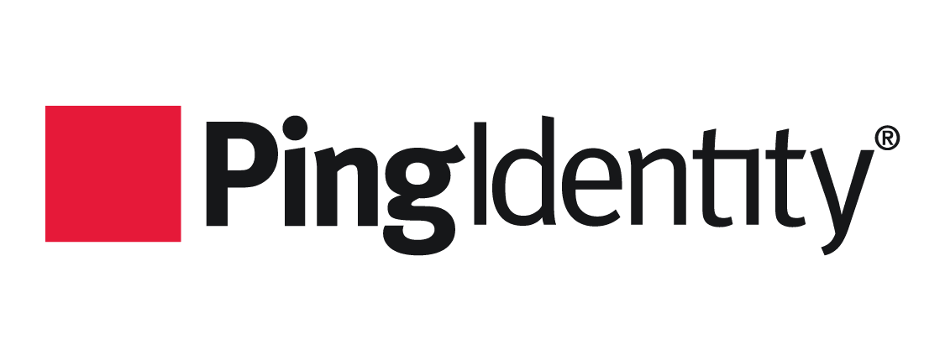
BOOTCAMP- III
PingIdentity

Slide 20
Introduction to PingIdentity
PingIdentity is a Commercial off the Shelf (COTS) web access management product provides secure and seamless access to applications on cloud, mobile, SaaS and on-premise applications. It provides Identity Access Management and single Sign-On (SSO) solution to enterprises and organizations across the industries.
Following products of PingIdentity were used during the Internship tenure:
PingDirectory: It is a fast, scalable directory used to store identity and profile data of the clients.
PingFederate: It is a central authentication solution allowing customers, and partners to securely access all of their web applications from any device.
PingAccess: It is a centralized access security solution that provides secure access to web applications

Slide 21
Open Standard Protocols
 | SAML 2.0 | OAuth 2.0 | OIDC 2.0
Acronym | Security Assertion Mark-up Language | Open Authorization | OpenID Connect
What is it? | Open standard for authentication & authorization | Open standard for authorization | Open standard for authentication
History | Developed by OASIS in 2001 | Developed by Twitter and Google in 2006 | Developed by OpenID foundation in 2014
Application | SSO For enterprise | API Authorization | SSO for consumer application
Format | XML | JSON | JSON
Protocols | HTTP, SOAP | HTTP | HTTP
The protocols used in PingIdentity are:
SAML 2.0
OAuth 2.0
OpenID Connect

Slide 22
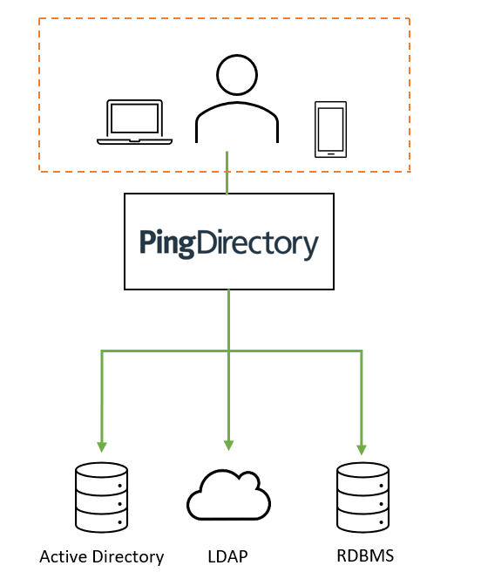
Introduction to PingDirectory
PingDirectory is a directory service, which securely stores and maintains identity of users at a large scale. LDAP is used to authenticate the identities.
PingDirectory is used by enterprises and organizations to store and manage sensitive customer, partner, and employee data, such as credentials, profiles, preferences, and privacy settings.

Slide 23
Use Case on PingDirectory
Problem Statement: How an organization with numerous employees, clients and external contractors would manage the access of their systems?
Solution: An organization comprising of large number of employees can manage the access of their employees by using Role based Access control.Instead of managing the access of each employee, it’s better to restrict the access based on roles. In this use case a group and subgroup has been created. In turn users are mapped to this group.

Slide 24
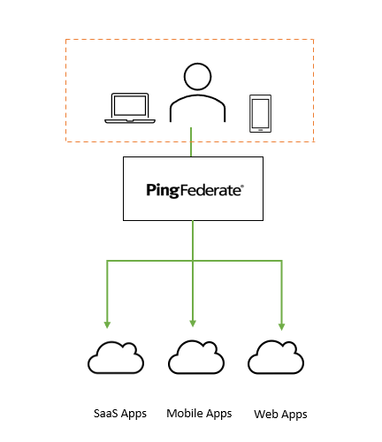
Introduction to PingFederate
PingFederate is a central federal authentication solution allowing customers to securely access all their applications from any device.
Open standard protocols such as SAML, OAuth 2.0 and OpenID Connect are supported by PingFederate.

Slide 25
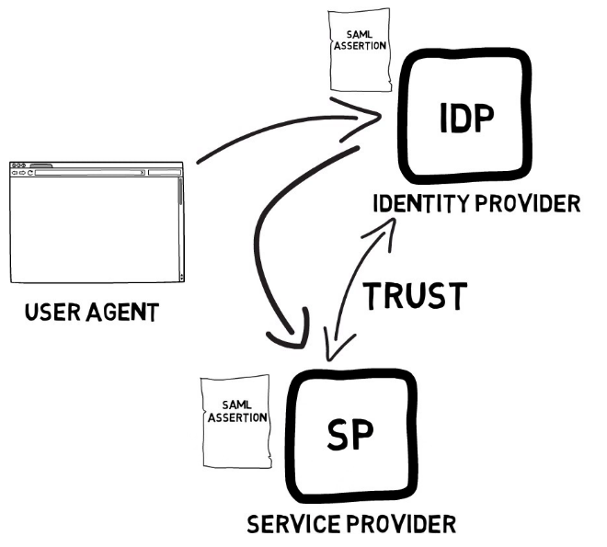
Supported Standards in PingFederate
SAML 2.0 is extensively used by the clients and customer of PingFederate to provide the solutions of Single Sign-On and federated identity management.
SAML protocol has three primary components:
User Agent: Generally, it is user’s browser.
Identity Provider (IdP): It is a centralized system where user credentials are stored. It is a system which authenticates user credentials.
Service Provider (SP): It provides services to end user.

Slide 26

Use Case I on PingFederate
Problem Statement: To Integrate a sample website using PingFederate.
Solution: IAM Showcase website is used as a Service Provider (SP) and PingFederate acts as an Identity Provider (IdP). An instance of Password Credential Validators (PCV) is used to create user credentials manually (username and password) in PingFederate. An IdP adapter is used to provide session information and user identification to PingFederate. SP connection is used to specify which application needs to be configured with IdP.

Slide 27
Use Case II on PingFederate
Problem Statement: To integrate a SaaS application using PingFederate.
Solution: In this use case Salesforce application is protected using PingFederate. SAML 2.0 is used as a protocol to establish SP connection between both the entities. A user is successfully authenticated using IdP initiated Single Sign-On and SP initiated SSO.

Slide 28
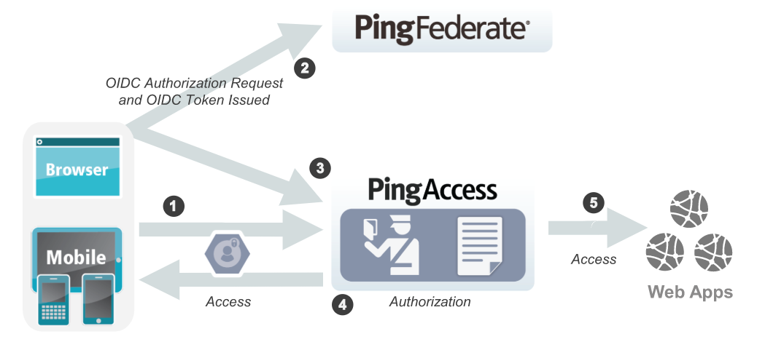
Introduction to PingAccess
Ping Access is a Web Access Management Solution.
Ping Access is used to protect websites, APIs, and other web resources using rules and other authentication criteria. It allows both internal and external users to access web applications securely.
Some Applications that don’t support SAML or may need granular access control. For that purpose, Ping Access is required

Slide 29
Supported Standards in PingAccess
Ping Access uses OAuth 2.0 and OpenID connect. These protocols allow to have a granular access in Ping Access.
Since OAuth was designed only for authorization so there is no standard way for getting user’s information. Hence OIDC is used to authenticate the users.
It is an extra identity layer added on top of the OAuth. It allows to check the identity of the user based on authorization done by authorization server.
OpenID
HTTP
OAuth 2.0

Slide 30
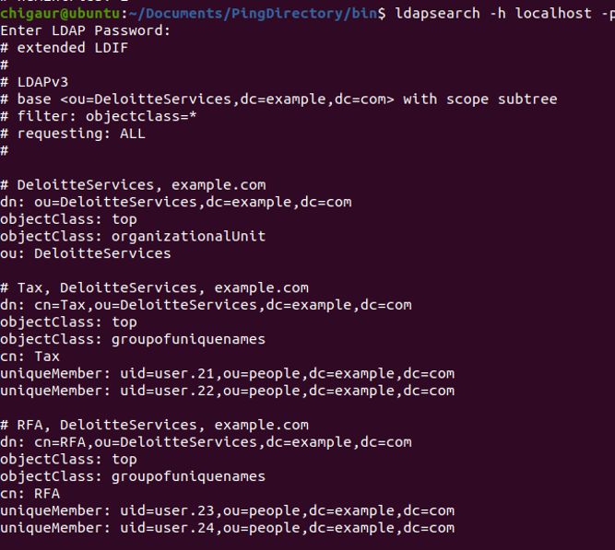
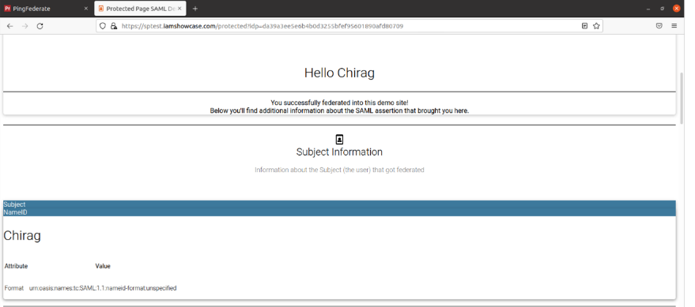
Results

Slide 31
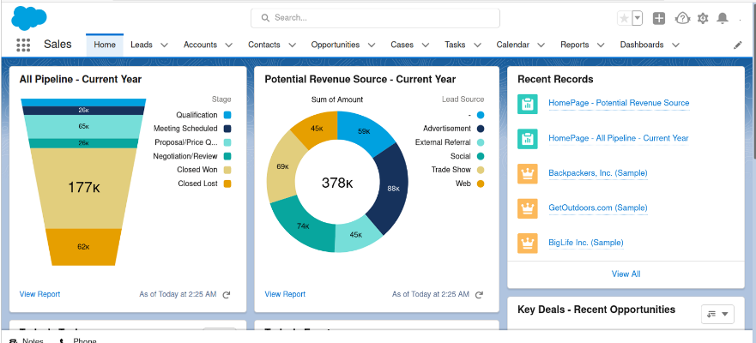
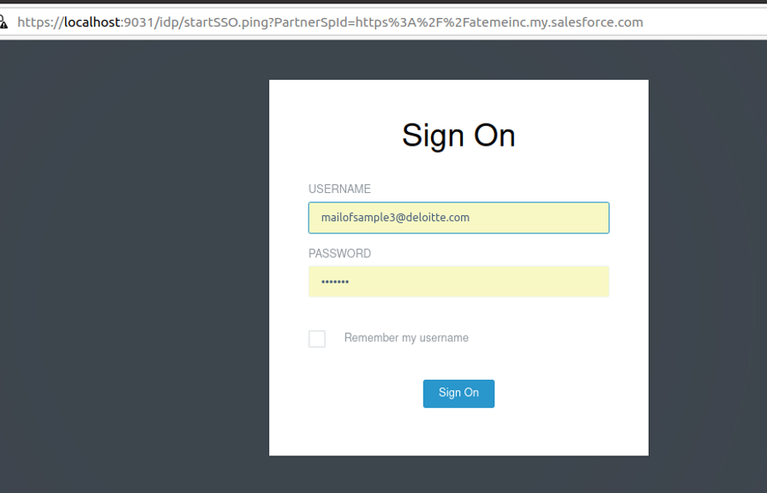

Slide 32
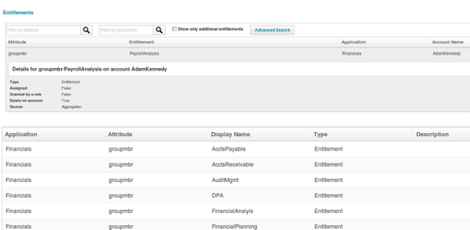
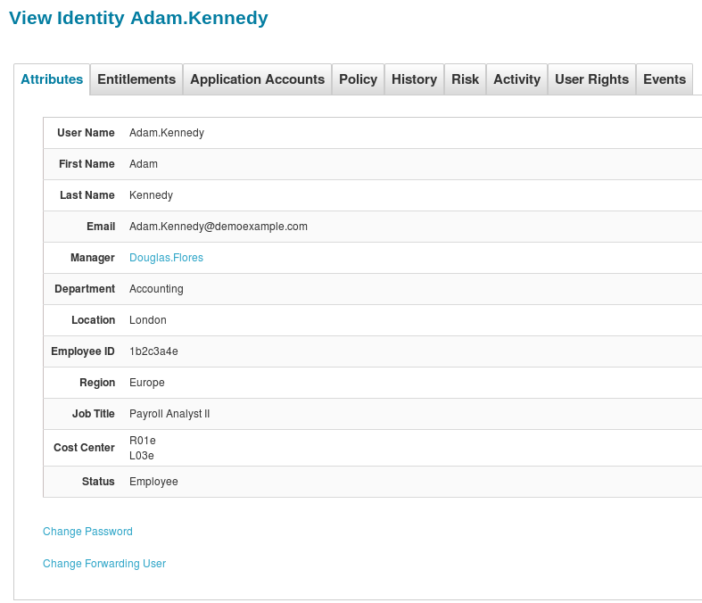

Slide 33

Conclusion
During my internship at Deloitte as a Risk and Financial Advisor, I had diverse possibilities to study and grow. I was given my possibility to research and hone my technical abilities in addition to conversation abilities to name a few.
The internship at Deloitte supplied me with a possibility to find out about Identity Access Management that is one of the critical elements of Cybersecurity. PingIdentity as a product being used to illustrate the principles of Federated identification Management, Identity Access Management and Single Sign On (SSO) solutions

Slide 34





Internship Timeline
January
Onboarding sessions were organized for 1 week. Boot Camp I was organized in January on IAM for 2 weeks.
Boot Camp II on SailPoint was held for weeks and later some training sessions on JAVA were organized.
March
Boot Camp III was held on Ping Identity Products to get a clear understanding of the products.
February
Early April
Later April
Several Use Cases on Ping Identity were demonstrated.
Shadowing my mentor on the client’s project using the understanding of IAM and Ping Identity.

Slide 35
References
Y. Ashibani and Q. H. Mahmoud, "An Intelligent Risk-Based Authentication Approach for Smartphone Applications," 2020 IEEE International Conference on Systems, Man, and Cybernetics (SMC), 2020, pp. 3807-3812, doi: 10.1109/SMC42975.2020.9283267.
R. Chivukula, T. Jaya Lakshmi, L. Ranganadha Reddy Kandula and K. Alla, "A Study of Cyber Security Issues and Challenges," 2021 IEEE Bombay Section Signature Conference (IBSSC), 2021, pp. 1-5, doi: 10.1109/IBSSC53889.2021.9673270.
A. Sharma, S. Sharma and M. Dave, "Identity and access management- a comprehensive study," 2015 International Conference on Green Computing and Internet of Things (ICGCIoT), 2015, pp. 1481-1485, doi: 10.1109/ICGCIoT.2015.7380701.
K. Li, A. Ren, Y. Ding, Y. Shi and X. Wang, "Research on Decentralized Identity and Access Management Model Based on the OIDC Protocol," 2020 International Conference on E-Commerce and Internet Technology (ECIT), 2020, pp. 252-255, doi: 10.1109/ECIT50008.2020.00065.
https://www.pingidentity.com/en/resources/blog/post/what-does-passwordless-really-mean.html
https://oauth.net/2/grant-types/authorization-code/
https://developer.okta.com/blog/2018/04/10/oauth-authorization-code-grant-type

Slide 36

Thank You!

